Slide 1
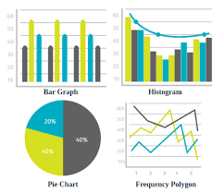
UIT2502 – Data Analytics & Visualization
Frequency Distribution

Slide 2
Introduction
Overview: Gives an idea of all values of some variable and the number of times they occur.
Definition: It is a table or graph that displays the frequency of various outcomes or values in a sample or population. It shows the number of times each value occurs in the data set.
Purpose: To organize and summarize the data by showing the frequency of the observations. This helps us identify the patterns in any given set of data.

Slide 3
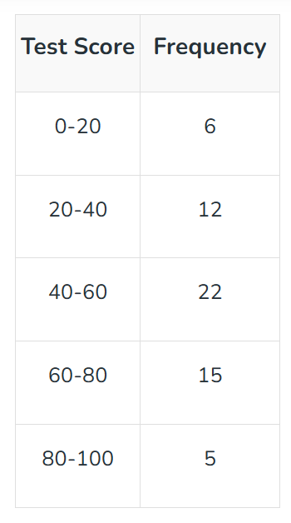
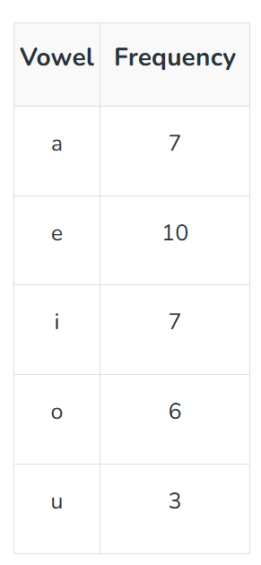
Frequency distribution table
A frequency distribution table is a way to organize and present data in a tabular form which helps us summarize the large dataset into a concise table.

Slide 4
Frequency distribution table
A frequency distribution table is a way to organize and present data in a tabular form which helps us summarize the large dataset into a concise table.
class intervals
individual data values
Grouped Frequency Distribution Table
Ungrouped Frequency Distribution Table

Slide 5
Types of frequency distribution
Grouped Frequency Distribution
Ungrouped Frequency Distribution
Relative Frequency Distribution
Cumulative Frequency Distribution

Slide 6
Example to understand types of frequency distribution
Make the Frequency Distribution Table for the ungrouped data given as follows:
23, 27, 21, 14, 43, 37, 38, 41, 55, 11, 35, 15, 21, 24, 57, 35, 29, 10, 39, 42, 27, 17, 45, 52, 31, 36, 39, 38, 43, 46, 32, 37, 25

Slide 7
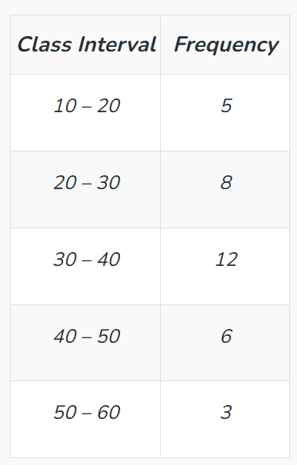
Grouped frequency distribution

Slide 8
Example to understand types of frequency distribution
Make the Frequency Distribution Table for the ungrouped data given as follows:
10, 20, 15, 25, 30, 10, 15, 10, 25, 20, 15, 10, 30, 25

Slide 9
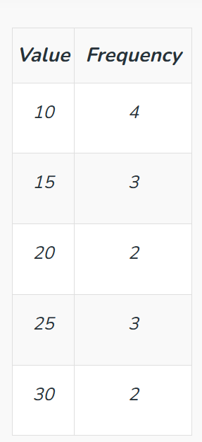
Ungrouped frequency distribution

Slide 10
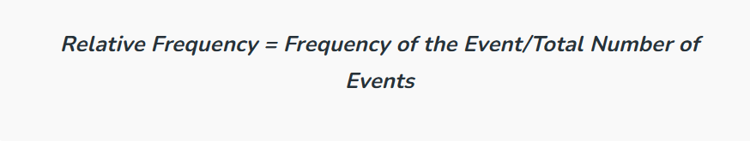
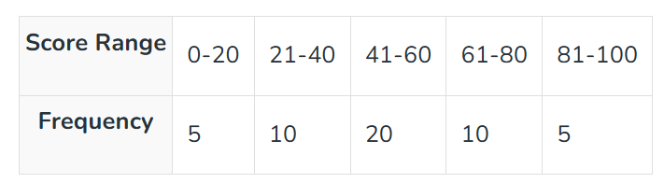
Relative frequency distribution
Make the Relative Frequency Distribution Table for the following data:

Slide 11
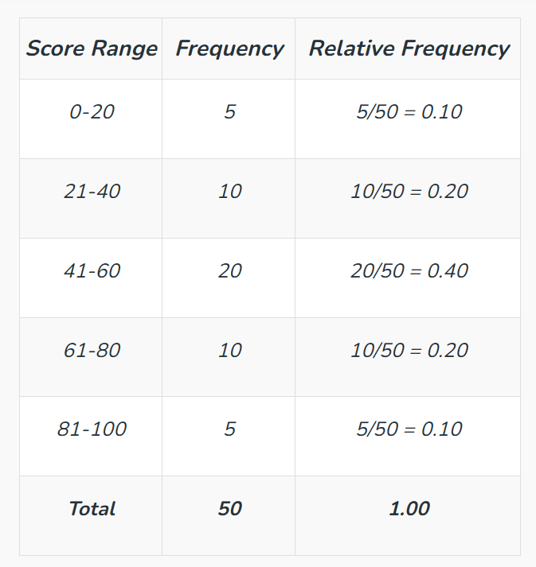
Relative frequency distribution

Slide 12
Cumulative frequency distribution
Sum of all the frequencies in the previous values or intervals up to the current one
Types:
Less than type: Sum all the frequencies before the current interval.
More than type: Sum all the frequencies after the current interval.

Slide 13
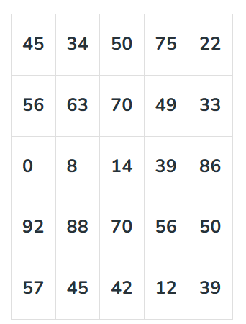
Example for cumulative frequency distribution
The table below gives the values of runs scored by Virat Kohli in the last 25 T-20 matches. Represent the data in the form of less-than-type cumulative frequency distribution:

Slide 14
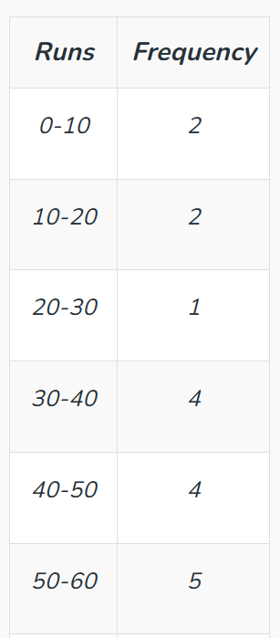
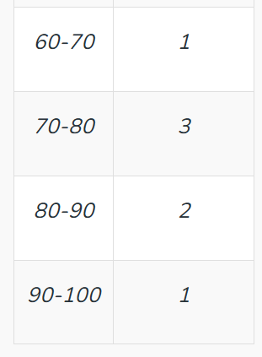
Example for cumulative frequency distribution

Slide 15
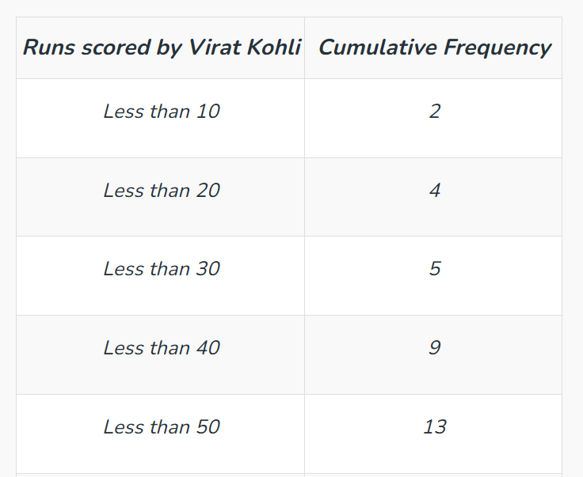
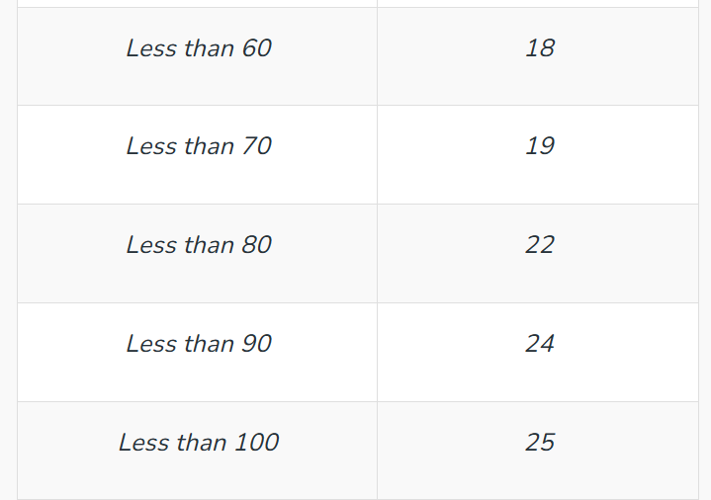
Example for cumulative frequency distribution Less than type

Slide 16
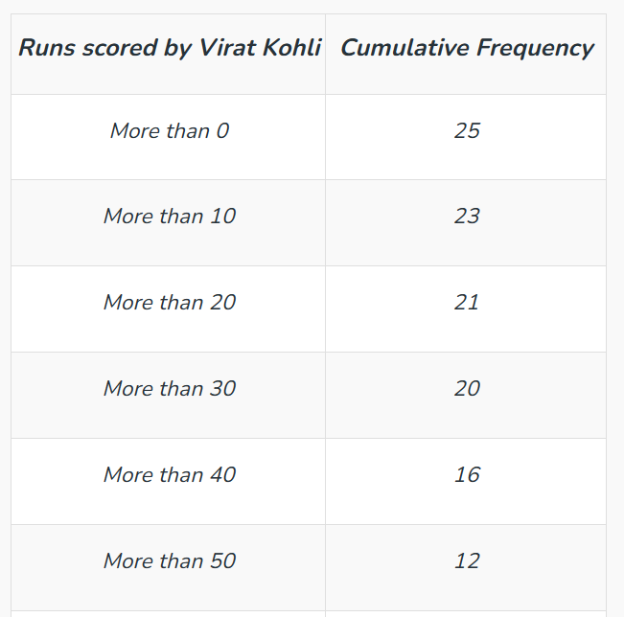
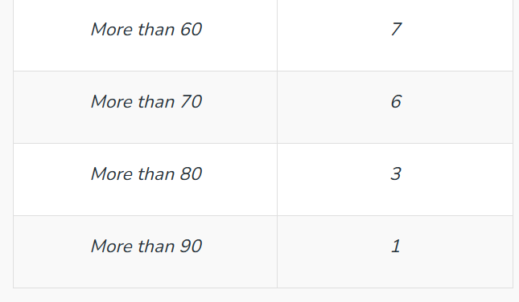
Example for cumulative frequency distribution More than type

Slide 17
Variability in Statistics
Spread or dispersion of data
Refers to how spread out a set of data is
Describing variability
Range
Interquartile range
Variance
Standard deviation
Everitt, B. S.; Skrondal, A. (2010), The Cambridge Dictionary of Statistics, Cambridge University Press.
Gonick, L. (1993). The Cartoon Guide to Statistics. HarperPerennial.

Slide 18
Describing variability
Range – Amount between the smallest and largest item in the set.
Interquartile range – A number that indicates how spreadout scores are and tells users what the range is in the middle of a set of scores.
Variance – Gives users a rough idea of how spread out the data is
Standard deviation – Tells a user how tightly their data is clustered around the mean
Everitt, B. S.; Skrondal, A. (2010), The Cambridge Dictionary of Statistics, Cambridge University Press.
Gonick, L. (1993). The Cartoon Guide to Statistics. HarperPerennial.

Slide 19
Describing variability
Variance – Gives users a rough idea of how spread out the data is
A small number for the variance means your data set is tightly clustered together and a large number means the values are more spread apart.
Everitt, B. S.; Skrondal, A. (2010), The Cambridge Dictionary of Statistics, Cambridge University Press.
Gonick, L. (1993). The Cartoon Guide to Statistics. HarperPerennial.

Slide 20
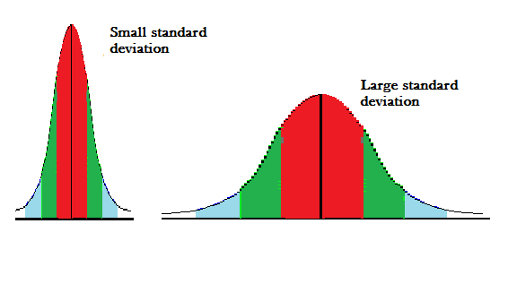
Describing variability
Standard deviation – Tells a user how tightly their data is clustered around the mean
A small SD indicates that your data is tightly clustered — you’ll also have a taller bell curve; a large SD tells you that your data is more spread apart.
Everitt, B. S.; Skrondal, A. (2010), The Cambridge Dictionary of Statistics, Cambridge University Press.
Gonick, L. (1993). The Cartoon Guide to Statistics. HarperPerennial.

Slide 21
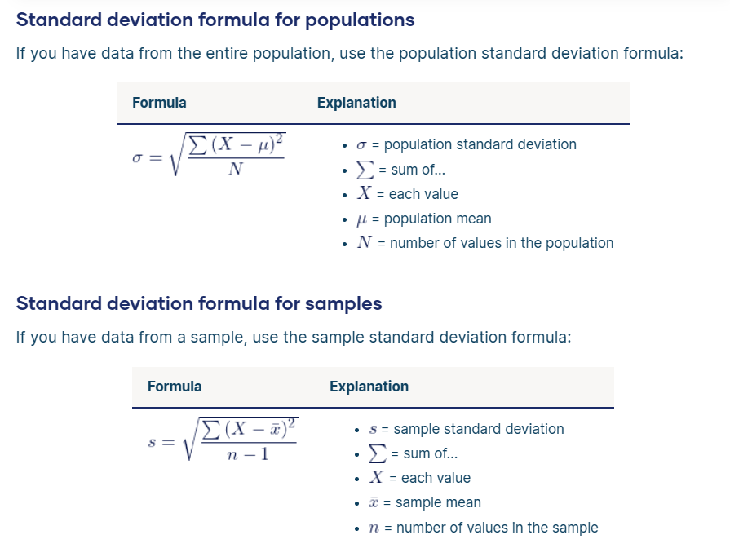
Standard deviation

Slide 22
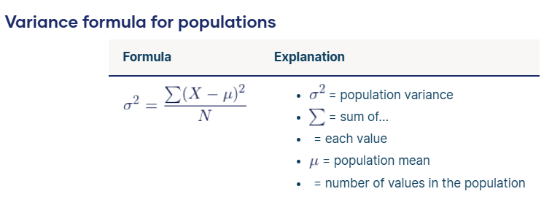
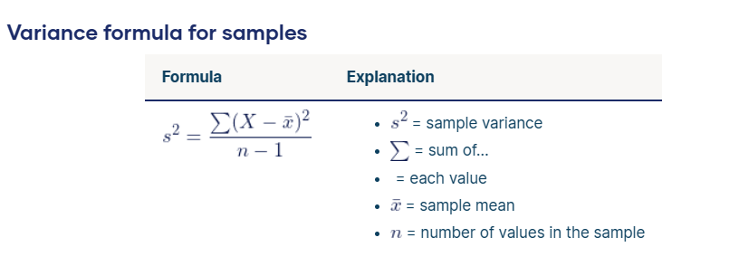
Variance

Slide 23
Variability in big data
Refers to the number of inconsistencies in the data.
Refers the multitude of data dimensions which result from the multiple disparate data types and sources available.

Slide 24
States of variability
Low variability - Better prediction of information about the population based on sample data
High variability - Values are less consistent, so it’s harder to make predictions
Data sets can have the same central tendency but different levels of variability or vice versa.
If you know only the central tendency or the variability, you can’t say anything about the other aspect.
Both of them together give you a complete picture of your data.

Slide 25
Best measure of variability
 | Range | Interquartile range | Standard Deviation | Variance
Level of measurement
Ordinal/ Category | Best | Best
Interval |  |  | Best | Best
Distribution
Normal |  |  | Best | Best
Skewed |  | Best

Slide 26
Co-efficient of variation
Describes the dispersion in data
Uses mean and standard deviation
Co-efficient of variation (C.V) = (SD/Mean of observations)*100
Observation:
The data with greater C.V. is said to be more variable and less stable than the other.
The series having lesser C.V. is said to be more consistent than the other.

Slide 27
When to use C.V
Let’s say we have two series, about the heights of students in a class.
Ex: Now one series measures height in cm and the other one in meters.
Ideally, both should have the same dispersion but the methods of measuring the dispersion are dependent on the units in which we are measuring.
This makes such comparisons hard.
For dealing with such problems, we define the Coefficient of Variation.

Slide 28
Example for Variability
Height | Asian Students | Western Students
Mean | 59.9 | 44.8
SD | 10.2 | 12.7
Comparative observation:
Looking at the standard deviations 10.2 and 12.7, the tests seems to have similar results.
Individual observation:
Variation in the mean has higher impact on the dispersion
Height | Asian Students | Western Students
Mean | 59.9 | 44.8
SD | 10.2 | 12.7
CV | 17.03 | 28.35

Slide 29
Books
TEXTBOOKS:
David Cielen, Arno D. B. Meysman, and Mohamed Ali, “Introducing Data Science”, Manning Publications, 2016. (first two chapters for Unit I).
Robert S. Witte and John S. Witte, “Statistics”, Eleventh Edition, Wiley Publications, 2017.
Jake VanderPlas, “Python Data Science Handbook”, O’Reilly, 2016.
REFERENCES:
Allen B. Downey, “Think Stats: Exploratory Data Analysis in Python”, Green Tea Press, 2014.

